Slide 1
COVID-19 in Herefordshire
Weekly intelligence summary
Public Health & Intelligence Unit
6th January 2021

Slide 2
Contents
Key messages (slide 3)
COVID-19 cases (slides 4-6), including demographics (slide 7-8) and local areas (slides 9-10)
Profile of deaths: published data (slide 11)
Wider impacts – national restrictions (slide 12)
Effects of lockdown on population movement (slide 13)
Other resources (slide 14)
If you need help to understand this document, or would like it in another format or language, please contact us on 01432 261944 or e-mail researchteam@herefordshire.gov.uk

Slide 3
Key messages
In light of continued rapid growth in new cases and increasing pressure on the NHS, the UK government announced a third national lockdown on Tuesday this week (5 Jan). More stringent than the English lockdown in November; schools will be closed until at least the middle of February, and shielding has been reintroduced for the most vulnerable. Legislation has been put in place to cover the period to 31 March.
As nationally, daily numbers of new cases are at unprecedented levels, and have been increasing rapidly since early December:
    The total number of lab-confirmed cases throughout the course of the pandemic is now 4,065 (4 Jan). This is 633 more than for the same time last week. This increase is the highest reported during the pandemic.
    The 7-day rate per 100,000 population has trebled since the middle of December, and the latest is 311 (1 Jan) - a third higher than the November peak of 159. It’s broadly in line with neighbouring authorities (except a lower rate in Powys), but remains half the English national rate and a third lower than the West Midlands region overall.
    The most recent increases have been driven by cases amongst 18-49 year-olds, with particularly high rates amongst 22-29 year-olds. The rate amongst people aged 80+ has fallen slightly in the last week, but rates remain relatively high in all ages.
    The highest rates and numbers are currently being seen in Hereford (North East, East, Central and South)
  Numbers of deaths involving Covid-19 are increasing: published ONS data has so far included 12 in the two weeks to 25 December (registered by 1 Jan). PHE data indicates that a further 18 have occurred since, which will appear in future weeks’ official counts. Despite this, overall deaths remain close to average for the time of year.
  Shielding support is being re-introduced for the most vulnerable.
  With cases so high across the whole county, it isn’t meaningful to attempt to report on outbreaks or situations at the moment. These are being monitored operationally, but the growth in cases is currently being driven by increasing community transmission.

Slide 4
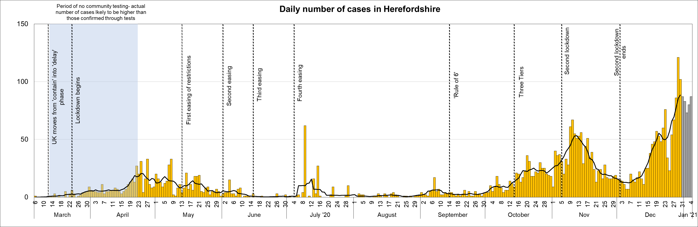

Lab-confirmed COVID-19 cases in Herefordshire
Lab-confirmed cases are the official count of people who live in Herefordshire and have tested positive for COVID-19. Numbers of confirmed cases are linked to the availability of testing, so the cases chart highlights key dates in testing policy.
The total lab-confirmed cases over the course of the epidemic is now 4,065 (4 Jan). This is 633 more than this time last week, all from swabs taken between 28 Dec and 4 Jan (note that reporting lags mean daily numbers can change, and the grey bars for the last 5 days will probably increase). This weekly increase is the highest recorded during the pandemic.
The line on the chart shows the average number of new cases each day. After reaching 53 on 12 Nov (10 days into lockdown), it fell sharply to 12 recorded on 7 December – similar to those seen in mid-October. However, numbers have since increased sharply and have been higher than the November peak since 20 December. As of 30 Dec the figure was 88 – the highest recorded to date. This local pattern mirrors that seen nationally.
Where can I find out more? Confirmed cases are updated daily by PHE at https://coronavirus.data.gov.uk/. These are used in tools such as the LG Inform Tracker.

Slide 5
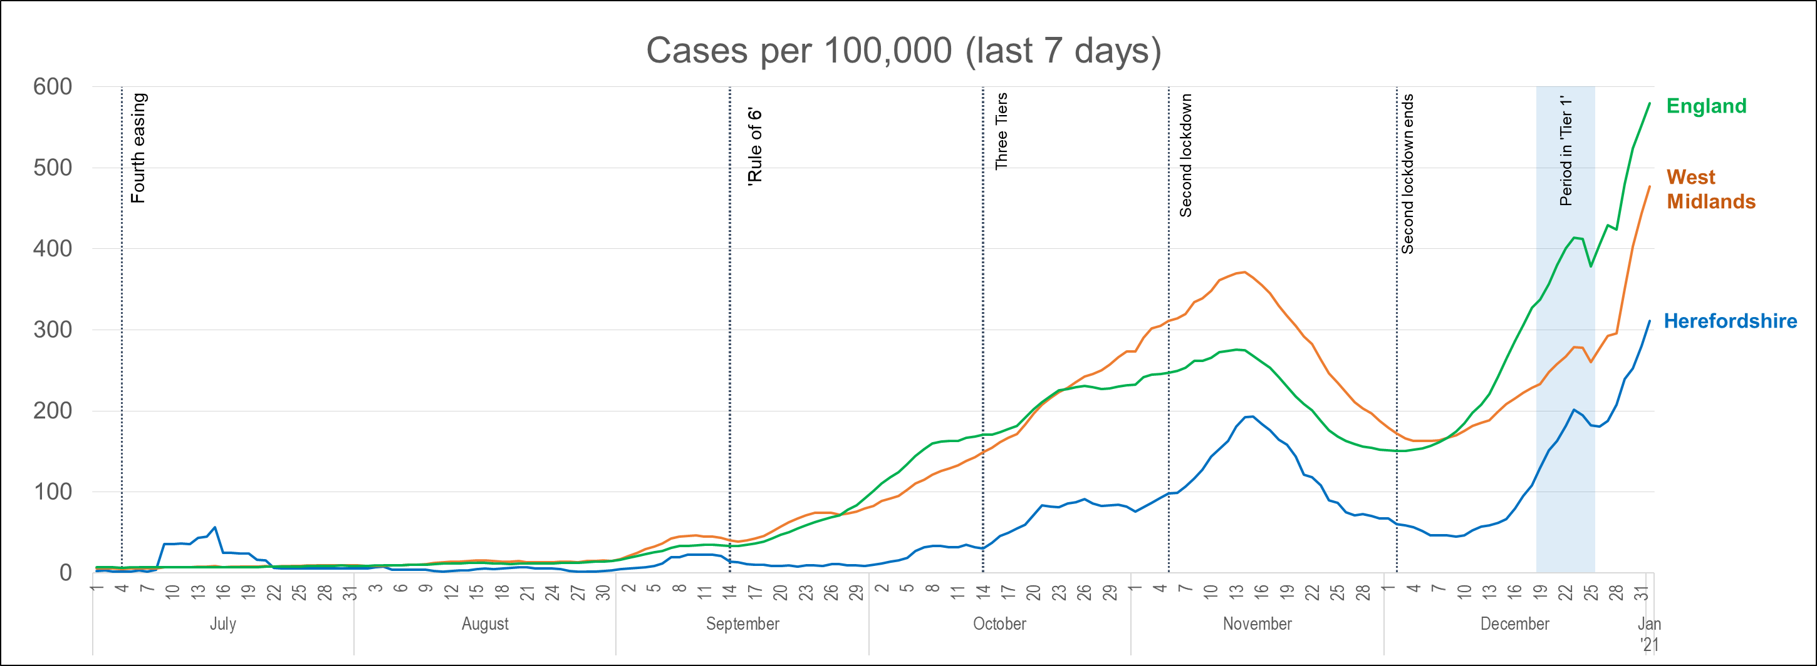
Lab-confirmed cases: comparisons
! Be aware !
Rates per 100,000 resident population give a fairer comparison of the number of cases in each area but they do not take account of the different rates of testing or differences in the age and sex of the local populations.
With one of the smallest ‘upper tier’ local authority populations (193,200), Herefordshire’s rate can be dramatically affected by relatively small changes in numbers of cases. An average of 28 cases a day in a week would result in a rate of 100 per 100,000.
These are not rates of infection amongst the population: they can only reflect those who have been tested, so numbers are highly dependent on the availability of tests.
The chart shows the recent trend in cases per 100,000 resident population for 7-day periods (the latest one ending 5 days ago to allow for lags in the results of tests). This rate is now commonly quoted in national reporting.
Case rates have been rising rapidly since early December (apart from a dip over the Christmas weekend), and are now at the highest they’ve ever been. The Herefordshire 7-day rate has more than trebled in the two weeks to 1 January and is currently 311 per 100,000. This is a third higher than the November peak of 192, which then fell as the national lockdown took effect.
The Herefordshire pattern follows that seen across both England and the West Midland although the local rate is still half the national figure and a third lower than regionally. As has been seen throughout the pandemic, the start of the December increase in Herefordshire lagged behind the national rise by about a week, but it has since caught up.
Where can I find out more? The graph is based on daily updated PHE data on lab-confirmed cases. Further comparisons are included in the LG Inform dashboard. You can also view the local 7-day case rates and numbers on the Herefordshire Council website.

Slide 6
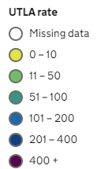
Lab-confirmed cases: comparison with neighbouring authorities
Latest published comparisons, for the week ending 31 December*, show:
Herefordshire’s rate increased by over 50% over the seven days to 31 December
Over this week, 7-day case rates increased in all bordering authorities (as indicated by the arrows).
Rates are currently similar in all neighbouring authorities, with only Powys notably lower than 300 per 100,000.
* Note that he slight lag in this data reflects the latest date for which complete data is available from test results
Time period: (25/12/20 to 31/12/20)
Where can I find out more? Maps comparing 7 day numbers of cases and rates per 100,000 people are updated daily by PHE at https://coronavirus.data.gov.uk/.

Slide 7
Demographics of COVID-19 cases in Herefordshire: age profile
Lab-confirmed cases each week by age
These charts show the age profile of lab-confirmed cases for each week since March: the top one shows absolute numbers of cases and the bottom one shows age-groups as a percentage of all cases that week
September and October saw a much younger profile of lab-confirmed cases than in the first wave in April and May, but increasing proportions of older people tested positive during November’s spike in cases, although the proportion of older people has fallen slightly since early December.
Whilst increased numbers have been seen in all age groups since early October, cases amongst older people are of particular concern as they are most likely to become acutely unwell and require hospitalisation.
% aged: | 18-30 | 65+ | All cases
First wave: April / May testing limited to suspected cases most at risk of serious illness | 14% | 37% | 653
September / October rising numbers of cases coinciding with return of schools and universities and general relaxing of restrictions. Rule of 6 implemented. | 31% | 16% | 586
November/December/January Highest numbers of confirmed cases to date | 21% | 18% | 1,692

Slide 8
Demographics of COVID-19: rates per 100,000 by age over time
This “heat map” shows how the 7-day rates per 100,000 for specific age groups have changed each week from July. Each row represents an age group. As rates increase, the chart colours become darker.
It is important to note that rates per 100,000 can be significantly affected by relatively small numbers of cases in a population as small as Herefordshire, even more so when broken down into age-groups. The absolute number of cases are shown as context.
The farm outbreak stands out in July, when rates were otherwise low for all ages for most of the summer. October shows the higher rates in 18-21 year-olds associated with students returning to university, followed by the rises in all age-groups prior to the November lockdown taking effect.
In the last three weeks rates have risen sharply in all ages, and last week’s overall rate of 308 per 100,000 is the highest seen to date. Some of this will be linked to increased testing of asymptomatic key workers identifying cases that would otherwise not have been recorded, but there has undoubtedly been increasing community transmission too.
The week to 1 January saw increases in all ages except 80+, with the sharpest rises amongst 18-49 year-olds. The highest rates are amongst 18-29 year-olds – 22% of cases amongst 12% of the population. Note that the timing of this spike coincides with the likely impact of the relaxation of restrictions under Tier 1, based on average incubation period.
The fall in the rate amongst people aged 80+ is likely to be due to an ongoing outbreak in a care home coming to an end. The figure still remains relatively high though, and as such, is a continuing cause for concern.

Slide 9
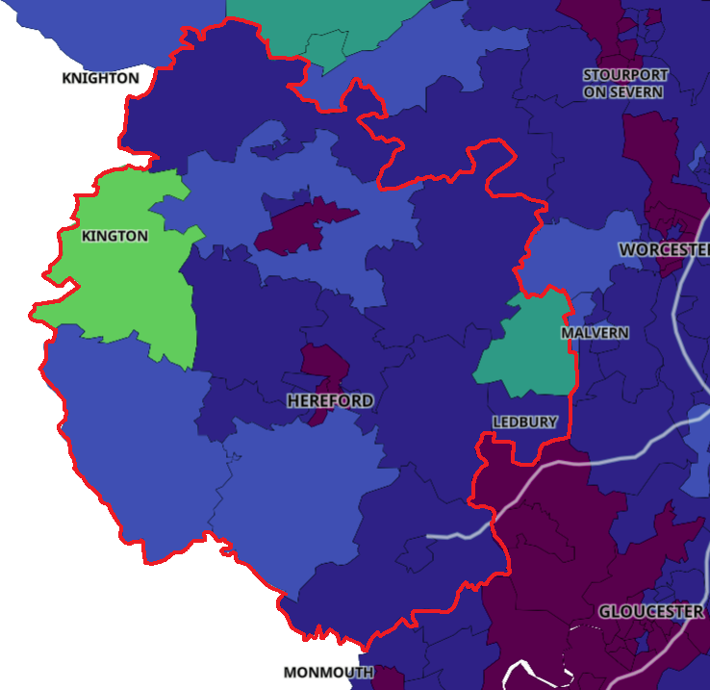
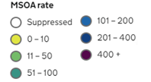
Lab-confirmed cases around the county: this week
Positive cases from samples taken in the 7 day period ending 31/12/20*
The map shows the latest 7-day rates of new cases per 100,000 population, as published by Public Health England: the darker the shading, the higher the rate (unshaded areas have had fewer than 3 cases in the last 7 days).
  - It’s important to note that these rates are very sensitive to small changes for small areas like MSOAs^. For instance, an increase of 1 case from 9 to 10 cases in an area of 10,000 people (about the size of Ledbury), would increase the rate from 90 to 100 per 100,000.
All of Herefordshire’s 23 MSOAs^ had 3 or more cases in the week to 31 December*:
  The highest area in terms of both numbers and rates were in ‘Hereford North East’ (55 cases, 708 per 100,000), although similar number of cases were also recorded in ‘Hereford Central’ (55 cases, 546 per 100,000). Rates in both areas were higher than the national average, as was ‘Hereford South’ (47 cases, 481 per 100,000).
  Rates in all other areas were lower than the national average.
Note that data for Wales is not included
* Note that the slight time-lag in this data reflects that test results are incomplete for the most recent few days
^ Middle super output areas: geographies designed by the Office for National Statistics in 2004 to have broadly similar population sizes – which means that they tend to be geographically bigger in rural Herefordshire.
Data supressed where numbers are low to avoid possible identification of individuals
Where can I find out more? This map of weekly confirmed cases by middle super output area (MSOA) in England are included in the PHE dashboard, which is updated daily.

Slide 10
Lab-confirmed cases around the county: trends in rates over time
Whilst the previous slide shows cases in the last 7 days, this “heat map” shows how the 7-day rates per 100,000 have changed in each area of Herefordshire from August. The areas (MSOAs*) are ranked by the rate in the last week with the highest at the top.
The heat map shows clearly how cases had generally been scattered across the county and were relatively low in all areas until mid-October. Following increases in early November, by 11 December rates had generally returned to mid-October levels.
However, in the last three week rates have increased in all 23 MSOAs and last week 17 areas recorded their highest figures to date
Of particular note are areas of north Hereford where rates are higher than the national average.
Some of the high rates can be explained by an outbreak in a care home, but overall, these patterns indicate a general increase in community transmission. In particular, evidence suggests an increase in household clusters in close proximity to each other (i.e. multiple cases in one household)
* Middle super output areas: geographies designed by the Office for National Statistics in 2004 to have broadly similar population sizes

Slide 11
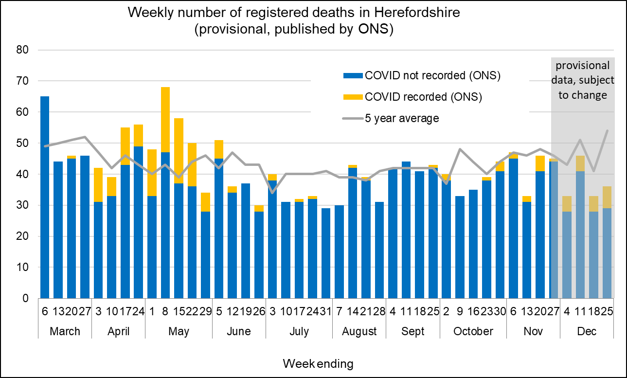
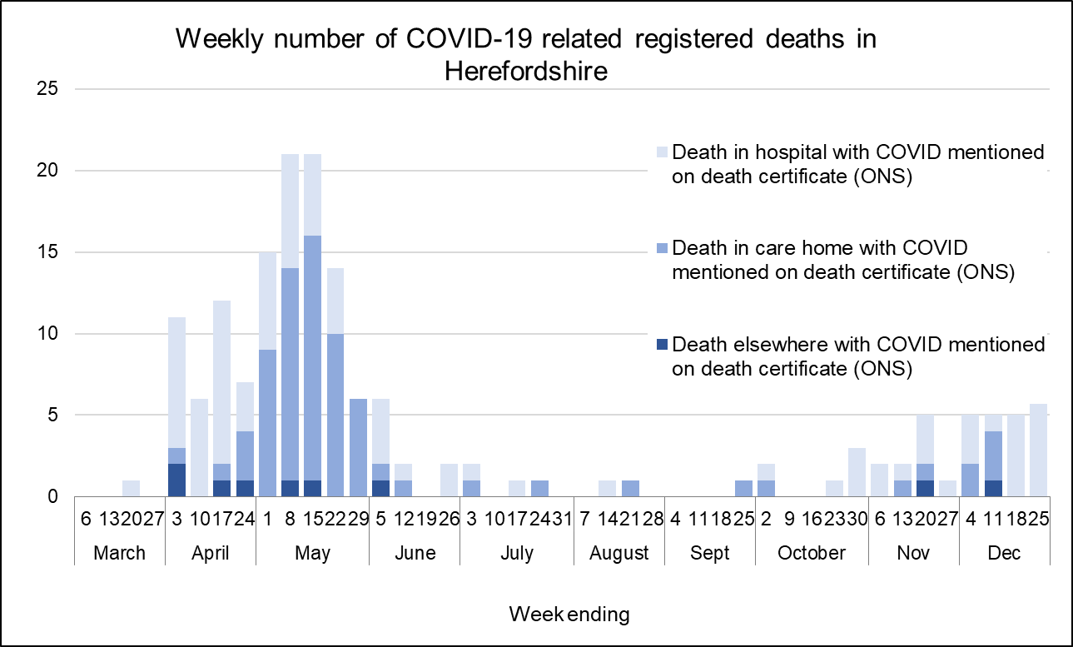
Profile of deaths: published data
Twelve deaths where COVID-19 was mentioned on the death certificate were included in the last two weeks published ONS data (occurring by 25 Dec and registered by 1 Jan). All were in hospital. This takes the official total amongst Herefordshire residents to 169 throughout the whole pandemic, and 21 during Dec.
Numbers of COVID related deaths have increased notably during the winter so far, with 27 recorded in the 6 weeks since mid November. There had been fewer than 20 in total between late June and early November.
Despite this, the overall number of deaths remain slightly below average levels for the time of year (between 40 and 50 a week) whereas nationally and regionally excess deaths have increased in recent weeks.
Of the 169: 72 have occurred in care homes, 88 in hospital (some of whom will have been care home residents), 5 at home and 4 in a hospice.
Public Health England are now publishing daily numbers of people who have died within 28 days of a first positive test for Covid-19:
  154 in total, a figure lower than that published by ONS as the latter does not require a positive test for COVID to be mentioned on a death certificate
  Of these deaths 18 have been registered since 25 Dec – these are likely to be counted in the next couple of weeks’ ONS death registration data.
Where can I find out more? ONS publish provisional data on weekly numbers of registered deaths by usual residence for local authorities every Tuesday, with an 11 day lag. Deaths recorded as COVID-19 by ONS include deaths where possible or confirmed COVID-19 is mentioned as any cause of death. They are therefore higher than the PHE figures, which only include those who have died following a positive test.

Slide 12
Wider impacts: clinically vulnerable people
In light of cases rising rapidly and increasing pressure on the NHS, the UK government announced a third national lockdown with immediate effect from 5 January. More stringent than the English lockdown in November; schools will be closed until at least the middle of February, and shielding has been reintroduced for the most vulnerable.
The official guidance says that clinically extremely vulnerable (CEV) people should “follow resumed shielding guidance and should:
  not attend work, school, college or university.
  limit the time you spend outside the home
  only go out for medical appointments, exercise or if it is essential.”
Local and national support systems are being
re-introduced, and CEV people needing support
are encouraged to register with the government’s
National Shielding Support Service (NSSS):
  390 registered in Herefordshire during November, with
  the majority (220) wanting priority online delivery slots
  70 requested contact from the council, and of the 50 who
  were able to be contacted, 15 needed support for either
  food or other reasons
  Around 20 people have registered since the NSSS was
  switched back on for Herefordshire on Sunday 31 December
People who have been identified as CEV since November,
and those who were in receipt of Talk Community support in
previous lockdowns will be contacted
Clinically Extremely Vulnerable: Shield
7,300 (4%)
Specific serious health conditions
Everyone:
Stay at home unless necessary. Stay 2 metres apart from anyone not in your household or bubble.
193,200
Herefordshire
residents
Clinically Vulnerable:
be especially careful & minimise contact with others
56,000 residents (1 in 3)
70+; eligible for annual flu jab
on medical grounds; pregnant
* People aged 60+ have also been identified as potentially being at higher risk. 26,100 residents are aged 60-69

Slide 13
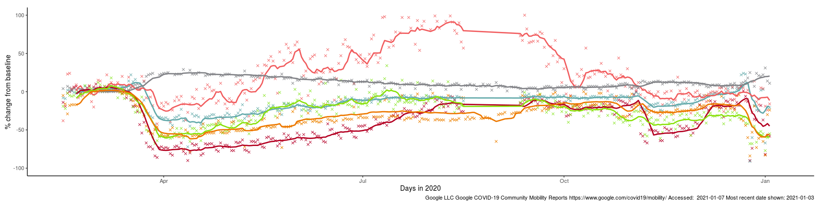
Effects of lockdown on population movement
This chart shows average visits to different categories of places, using location data of Google users, compared to the beginning of 2020.
Visits to all categories except residential fell in November during the English national restrictions (“Lockdown 2.0”), but not to the levels seen at the end of March.
Unsurprisingly, ‘retail and recreation’ – places like restaurants, cafés, shopping centres, museums, libraries and cinemas which had to close – saw the sharpest drop. However, there was a noticeable upturn at the end of the second lockdown - unsurprisingly movement increased marginally prior to Christmas and tailed off over the holiday period.
Only visits to ‘parks’ exceeded their baseline level after the full lockdown, but this may be a seasonal effect (comparable data for last summer is not available) as since November access has been close to the baseline. The other categories saw gradual increases, but never returned to their baseline levels and are yet to show any impact of the end of lockdown 2.0 and have also shown predictable declines over Christmas.
Changing visits in Herefordshire to…
Full national lockdown (23 Mar)
English lockdown 2.0 (5 Nov)
Residential
Parks
Grocery & pharmacy
Retail & recreation
Stations
English lockdown 2.0 ends (2 Dec)
Workplaces
Where can I find out more? This chart is updated daily on the Data Orchard website, using data published by Google at www.google.com/covid19/mobility/. The baseline is the median value, for the corresponding day of the week, during the five weeks 3 Jan–6 Feb 2020. Note that the data is based on movements of those who have opted to turn on location history in their Google accounts on their mobile devices.

Slide 14
Other resources
Wider vulnerabilities
  A factsheet of the numbers of people in Herefordshire likely to be affected by different aspects of the virus and the measures taken to control its spread can be downloaded from the Understanding Herefordshire website (produced March 2020)
  A monthly monitor of key economic recovery indicators: contact the intelligence unit
New research and open access analytical tools are continually emerging. As well as the sources linked to throughout these slides, you may be interested in:
  The Office for National Statistics' daily coronavirus roundup: the latest research into the effects on the economy and society
  The Health Foundation - COVID-19 policy tracker: an interactive timeline of key events and government policy announcements related to coronavirus
  An LG Inform dashboard tailored to Herefordshire & Worcestershire, showing daily updates in cases and comparisons with other areas.
  A Herefordshire Council dashboard provides up to date information on cases in the county and provides links to other useful information.

